Slide 1

FLIGHT TRAVEL AND ASSEMBLY LINE SCHEDULING Computer Science and Engineering 2nd year
CSE 254 ALGORITHM DESIGN AND ANALYSIS PRANAY MUNDA - 160001045 AKASH AHIRWAL – 160001002
Under the Guidance of
Dr. Kapil Ahuja

Slide 2
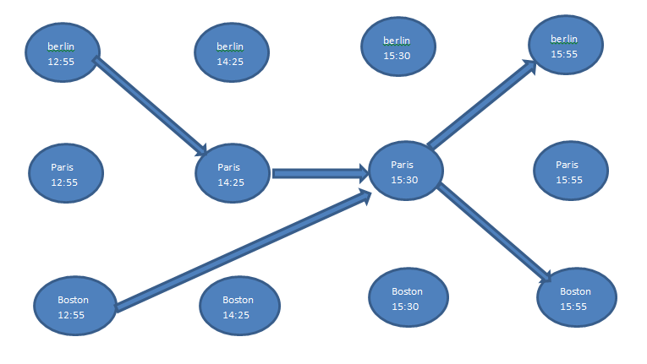
FLIGHT TRAVEL SCHEDULING
The diagram below show the approach of the flight from the source to the destination

Slide 3
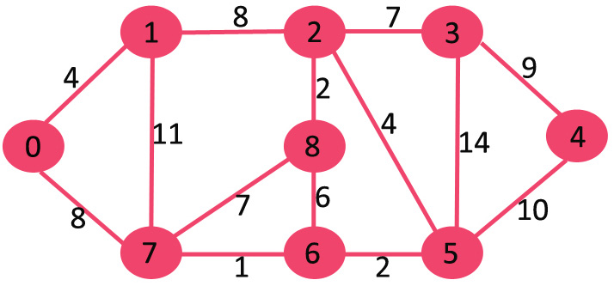
The following diagram if denoting the airport and the paths available with the distance between them. We are taking time of flight from one point to another equal to distance between them. In this program we are using dijkstra’s algorithm to find the shortest path from the source which in this case is (0).

Slide 4
We are storing the distance between the points in a matrix where the index of the matrix is determines the points which we are referring to.
graph[V][V] = {{0, 4, 0, 0, 0, 0, 0, 8, 0},
{4, 0, 8, 0, 0, 0, 0, 11, 0},
{0, 8, 0, 7, 0, 4, 0, 0, 2},
{0, 0, 7, 0, 9, 14, 0, 0, 0},
{0, 0, 0, 9, 0, 10, 0, 0, 0},
{0, 0, 4, 14, 10, 0, 2, 0, 0},
{0, 0, 0, 0, 0, 2, 0, 1, 6},
{8, 11, 0, 0, 0, 0, 1, 0, 7},
{0, 0, 2, 0, 0, 0, 6, 7, 0}
};
For example: if we are take i = 0 and j = 1 its value is 4 which is the distance between the points and same for i=0 and j = 1, since the index is representing the airports.

Slide 5
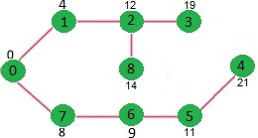
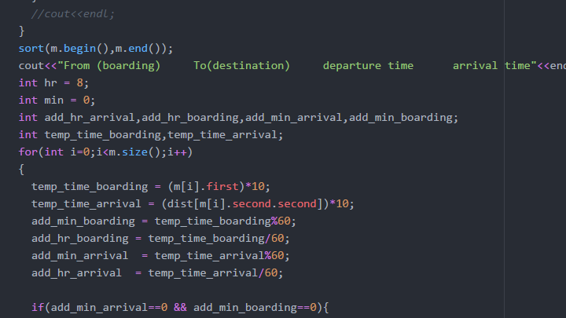
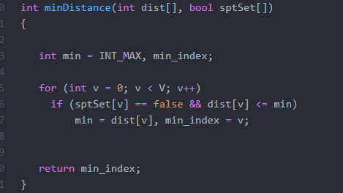
This is the final outcome which is showing the path of the flight between which stations so that minimum path is obtained covering all the points.
We are using this format to calculate the time while is also explained in upcoming slides.

Slide 6
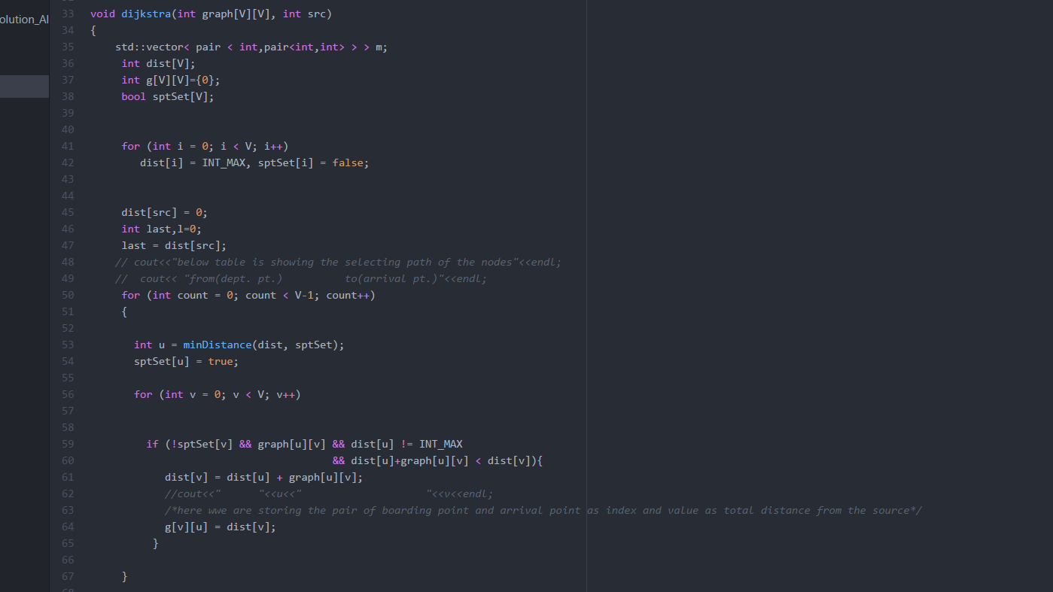
Dijkstra algorithm

Slide 7
The schedule is made so the distance between the source and the destination will be minimum. As in the above case following are the distances from the source …
0 is the source and distance is shown corresponding to the points.
1 - 4
2 - 12
3 - 19
4 - 21
5 - 11
6 - 9
7 - 8
8 - 14

Slide 8
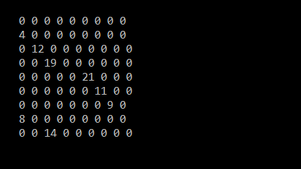
While the dijkstra’s program was running to find the path we are storing the value in a matrix. Such a way that columns index of the matrix are representing the boarding point and row index while represent arrival point and the value sorted in it is the total distance it is from the source image below is shown.
After that we have made the pair of this index and distance value of the j index which is the boarding point , and zero(0) are left over.
After that we have sorted the pair using distance value.
For timing we are assuming the ‘1’ distance unit will take 10 minutes.
Time of starting of the journey is 8:00 A.M. we are displaying the time in 24hrs clock.
Time is taken in minutes . So, for 12 unit distance the total minute is 12*10 = 120 minutes which will arrive at 10:00 to its mentioned point.

Slide 9
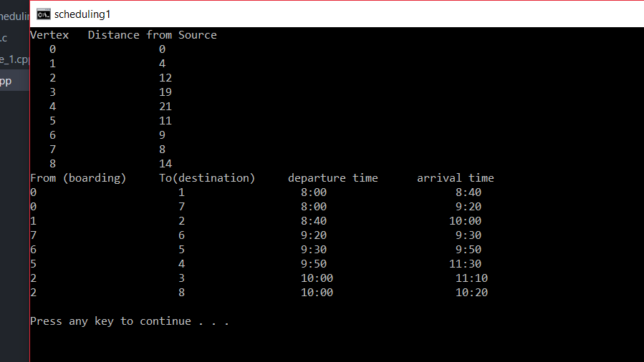
Final result which we are getting…..

Slide 10
The final result will be in the form mentioned below
From (boarding) | To(destination) | Departure time | Arrival time
0 | 1 | 8:00 | 8:40
0 | 7 | 8:00 | 9:20
1 | 2 | 8:40 | 10:00
7 | 6 | 9:20 | 9:30
From 0 to point : | Minimum distance
1 | 4
2 | 12
3 | 19
4 | 21

Slide 11
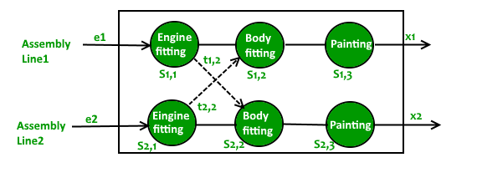
Assembly line
In this we have used the dynamic programming, to find the minimum time taken to complete the task which is assembly .

Slide 12
Two assembly lines are given “n” stations.
Parallel station does same job but for different time cost.
Moving the flight form one assembly line to other also takes time which is stored in a matrix.
Data is sorted in the following way :
a[][] = {{4, 5, 3, 2},
{2, 10, 1, 4}};
t[][] = {{0, 7, 4, 5},
{0, 9, 2, 8}};
e[] = {10, 12}
x[] = {18, 7}
Where ‘a[i][j]’ is the assembly line , ‘i’ represent the which assembly line is selected and ‘j’ represent which station is selected.
t[i][j] is the time taken to shift the plane from one assembly line to other of that station to the next one.
e[][] is the entry time and x[][] is the exit time given .

Slide 13
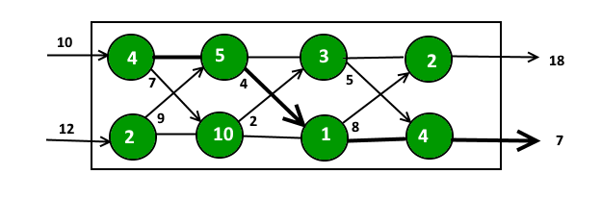
Following algorithm is used :
T1[i] = min(T1[i-1] + a[0][i], T2[i-1] + t[1][i] + a[0][i]);
T2[i] = min(T2[i-1] + a[1][i], T1[i-1] + t[0][i] + a[1][i]);
We are displaying the path as assembly line number followed by station number : (Assembly line no.,station number).
And at last the total time taken.

Slide 14
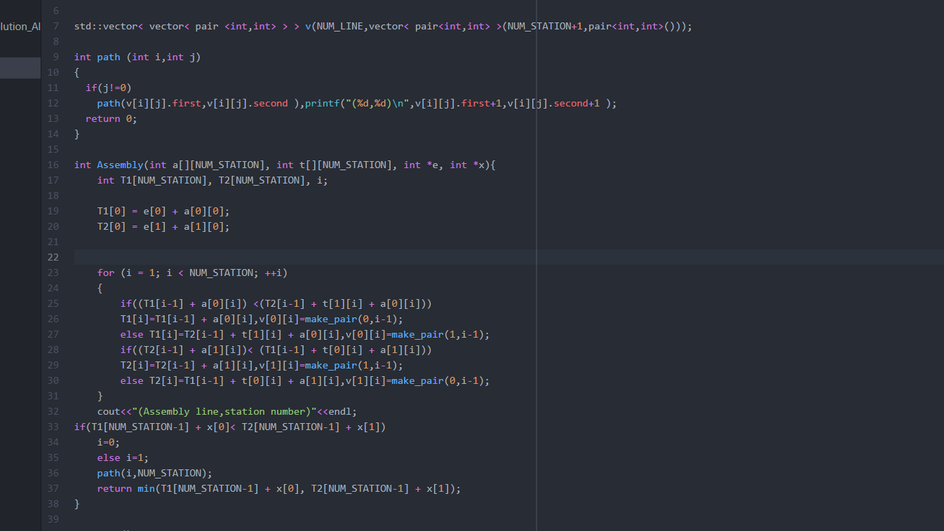
Code which we have used……

Slide 15
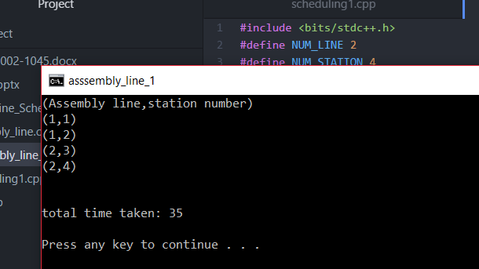
Final result which we are getting …

